Slide 1
Kubernetes Cluster

Slide 2
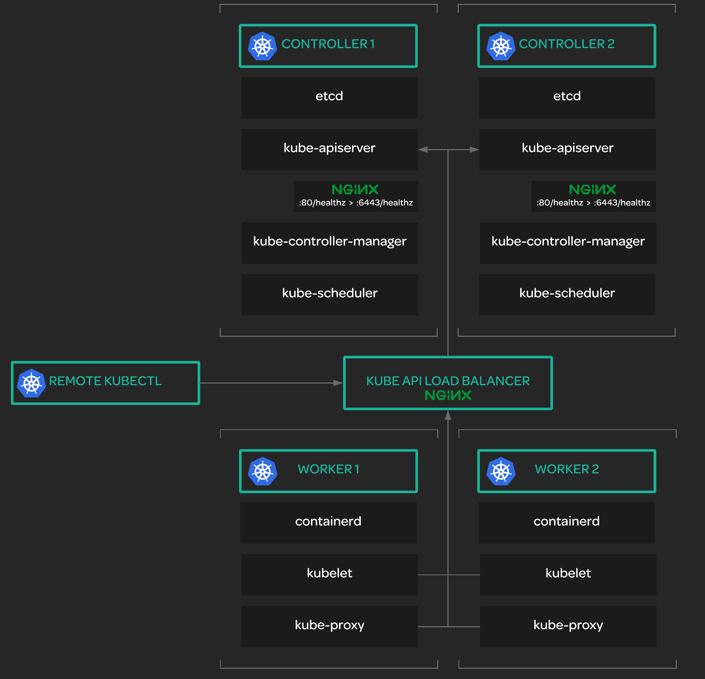
What Does the Kubernetes Cluster Architecture Look Like?

Slide 3
Prerequisites
We will leverage GCP for our infrastructure needs.
Sign up for a $300 credit in GCP
Install the Google cloud SDK
Set a default compute region and zone
Create a new project on GCP and make in the default in the CLI
If you want to run commands in parallel consider using TMUX

Slide 4
Installing the Client tools
In this section, we will be provisioning a certificate authority (CA). We will then use the CA to generate several certificates.
Certificates are used to confirm (authenticate) identity. They are used to prove that you are who you say you are.
A Certificate Authority provides the ability to confirm that a certificate is valid. A certificate authority can be used to validate any certificate that was issued using that certificate authority.
Kubernetes uses certificates for a variety of security functions, and the different parts of our cluster will validate certificates using the certificate authority.
In this section, we will generate all of these certificates and copy the necessary files to the servers that need them.

Slide 5
What Certificates do we need?
After we provision the certificate authority, we will need to generate certificates for the following:
Client Certificates – These certificates provide client authentication for various users: admin, kube- controller-manager, kube-proxy, kube-scheduler, and the kubelet client on each worker node.
Kubernetes API Server Certificate – This is the TLS certificate for the Kubernetes API.
Service Account Key Pair – Kubernetes uses a certificate to sign service account tokens, so we need to provide a certificate for that purpose.

Slide 6
Kubeconfigs
A Kubernetes configuration file, or kubeconfig, is a file that stores “information about clusters, users, namespaces, and authentication mechanisms.” It contains the configuration data needed to connect to and interact with one or more Kubernetes clusters.
You can find more information about kubeconfigs in the Kubernetes documentation:
https://kubernetes.io/docs/concepts/configuration/organize-cluster-access-kubeconfig/
Kubeconfigs contain information such as:
The location of the cluster you want to connect to
What user you want to authenticate as
Data needed in order to authenticate, such as tokens or client certificates
You can even define multiple contexts in a kubeconfig file, allowing you to easily switch between multiple clusters.

Slide 7
Why do we need Kubeconfigs?
We use kubeconfigs to store the configuration data that will allow the many components of Kubernetes to connect to and interact with the Kubernetes cluster.
How will the kubelet service on one of our worker nodes know how to locate the Kubernetes API and authenticate with it? It will use a kubeconfig!
In the next lesson, we will generate the kubeconfigs that our cluster needs.

Slide 8
How to Generate a Kubeconfig?
Kubeconfigs can be generated using kubectl:
Use kubectl config set-cluster to set up the configuration for the location of the cluster.
Use kubectl config set-credentials to set the username and client certificate that will be used to authenticate.
Use kubectl config set-context default to set up the default context.
Use kubectl config use-context default to set the current context to the configuration we provided.

Slide 9
What Kubeconfigs Do we need to generate?
We will need several Kubeconfig files for various components of the Kubernetes cluster:
Kubelet (one for each worker node)
Kube-proxy
Kube-controller-manager
Kube-scheduler
Admin

Slide 10
Kubernetes Secret Encryption
Kubernetes supports the ability to encrypt secret data at rest. This means that secrets are encrypted so that they are never stored on disc in plain text.
This feature is important for security, but in order to use it we need to provide Kubernetes with an encryption key.
We will generate an encryption key and put it into a configuration file. We will then copy that file to our Kubernetes controller servers.
You can find more information on Kubernetes secret encryption in the official docs: https://kubernetes.io/docs/tasks/administer-cluster/encrypt-data/

Slide 11
What is etcd?
“etcd is a distributed key value store that provides a reliable way to store data across a cluster of machines.” https://coreos.com/etcd/
etcd provides a way to store data across a distributed cluster of machines and make sure the data is synchronized across all machines.
You can find more information, as well as the etcd source code, in the etcd GitHub repository: https://github.com/coreos/etcd

Slide 12
How is etcd Used in Kubernetes?
Kubernetes uses etcd to store all of its internal data about cluster state.
This data needs to be stored, but it also needs to be reliably synchronized across all controller nodes in the cluster. etcd fulfills that purpose.
We will need to install etcd on each of our Kubernetes controller nodes and create an etcd cluster that includes all of those controller nodes.
You can find more information on managing an etcd cluster for Kubernetes here: https://kubernetes.io/docs/tasks/administer-cluster/configure-upgrade-etcd/

Slide 13
What is the Kubernetes Control Plane?
The Kubernetes control plane is a set of services that control the Kubernetes cluster.
Control plane components “make global decisions about the cluster (e.g., scheduling) and detect and respond to cluster events (e.g., starting up a new pod when a replication controller’s replicas field is unsatisfied).”
You can find more information on the control plane in the official Kubernetes documentation:
https://kubernetes.io/docs/concepts/overview/components/#master-components

Slide 14
Kubernetes Control Plane Components
The Kubernetes control plane consist of the following components:
kube-apiserver: Serves the Kubernetes API. This allows users to interact with the cluster.
etcd: Kubernetes cluster datastore. (We’ve already installed this one.)
kube-scheduler: Schedules pods on available worker nodes.
kube-controller-manager: Runs a series of controllers that provide a wide range of functionality. More here: https://kubernetes.io/docs/reference/command-line-tools-reference/kube-controller-manager/
cloud-controller-manager: Handles interaction with underlying cloud providers. (We won’t use this one in the course.)
The control plane components will need to be installed on each controller node.

Slide 15
Why Do We Need to Enable HTTP Health Checks?
The load balancer needs to be able to perform health checks against the Kubernetes API to measure the health status of API nodes.
The GCP load balancer cannot easily perform health checks over HTTPS, so the guide instructs us to set up a proxy server to allow these health checks to be performed over HTTP.
Since we are using Nginx as our load balancer, we don’t actually need to do this, but it will be good practice for us.

Slide 16
Why Do We Need to Set up RBAC for Kubelet Authorization?
RBAC: Role-Based Access Control We need to make sure that the Kubernetes API has permission to access the Kubelet API on each node and perform certain common tasks.
Without this, some functionality will not work.
We will create a ClusterRole with the necessary permissions and assign that role to the Kubernetes user with a ClusterRoleBinding.

Slide 17
What Are the Kubernetes Worker Nodes?
Kubernetes worker nodes are responsible for the actual work of running container applications managed by Kubernetes.
“The Kubernetes node has the services necessary to run application containers and be managed from the master systems.”
You can find more information about Kubernetes worker nodes in the Kubernetes documentation:
https://kubernetes.io/docs/concepts/architecture/
https://github.com/kubernetes/community/blob/master/contributors/design- proposals/architecture/architecture.md#the-kubernetes-node

Slide 18
Kubernetes Worker Node Components
Each Kubernetes worker node consists of the following components:
kubelet: Controls each worker node, providing the APIs that are used by the control plane to manage nodes and pods, and interacts with the container runtime to manage containers.
kube-proxy: Manages iptables rules on the node to provide virtual network access to pods.
Container runtime: Downloads images and runs containers. Two examples of container runtimes are
Docker and containerd (Kubernetes the Hard Way uses containerd). These components will need to be installed on each worker node.

Slide 19
What Is Kubectl?
We have already used kubectl in this course!
Kubectl is the Kubernetes command line tool. It allows us to interact with Kubernetes clusters from the command line.
You can find more information about kubectl in the official docs:
https://kubernetes.io/docs/reference/kubectl/overview/
We will set up kubectl to allow remote access from our machine in order to manage the cluster remotely.
To do this, we will generate a local kubeconfig that will authenticate as the admin user and access the Kubernetes API through the load balancer.

Slide 20
The Kubernetes Networking Model
You can find more information on Kubernetes cluster networking in the official docs:
https://kubernetes.io/docs/concepts/cluster-administration/networking/

Slide 21
What Problems Does the Networking Model Solve?
How will containers communicate with each other?
What if the containers are on different hosts (worker nodes)?
How will containers communicate with services?
How will containers be assigned unique IP addresses? What port(s) will be used?

Slide 22
The Docker Model
Docker allows containers to communicate with one another using a virtual network bridge configured on the host.
Each host has its own virtual network serving all of the containers on that host.
But what about containers on different hosts? We have to proxy traffic from the host to the containers, making sure no two containers use the same port on a host.
The Kubernetes networking model was created in response to the Docker model. It was designed to improve on some of the limitations of the Docker model.

Slide 23
The Kubernetes Networking Model
One virtual network for the whole cluster.
Each pod has a unique IP within the cluster.
Each service has a unique IP that is in a different range than pod IPs.

Slide 24
Cluster Network Architecture
Some Important CIDR ranges:
Cluster CIDR: IP range used to assign IPs to pods in the cluster. In this course, we’ll be using a cluster CIDR of 10.200.0.0/16.
Service Cluster IP Range: IP range for services in the cluster. This should not overlap with the cluster CIDR range! In this course, our service cluster IP range is 10.32.0.0/24.
Pod CIDR: IP range for pods on a specific worker node. This range should fall within the cluster CIDR but not overlap with the pod CIDR of any other worker node. In this course, our networking plugin will automatically handle IP allocation to nodes, so we do not need to manually set a pod CIDR.

Slide 25
What Does DNS Do Inside a Pod Network?
Provides a DNS service to be used by pods within the network.
Configures containers to use the DNS service to perform DNS lookups. For example:
You can access services using DNS names assigned to them.
You can access other pods using DNS names.
You can find more info in the Kubernetes docs:
https://kubernetes.io/docs/concepts/services-networking/dns-pod-service/

Slide 26
Smoke Testing the Cluster
Congratulations! At this point, we have finished setting up our cluster.
Now we want to run some basic smoke tests to make sure everything in our cluster is working correctly.
We will test the following features:
Data encryption
Deployments
Port forwarding
Logs
Exec
Services
Untrusted workloads

Slide 27
Smoke Testing Data Encryption
Goal: Verify that we can encrypt secret data at rest.
Strategy:
Create a generic secret in the cluster.
Dump the raw data from etcd and verify that it is encrypted.

Slide 28
Smoke Testing Deployments
Goal: Verify that we can create a deployment and that it can successfully create pods.
Strategy:
Create a simple deployment.
Verify that the deployment successfully creates a pod.

Slide 29
Smoke Testing Port Forwarding
Goal: Verify that we can use port forwarding to access pods remotely.
Strategy:
Use kubectl port-forward to set up port forwarding for an Nginx pod.
Access the pod remotely with curl.

Slide 30
Smoke Testing Logs
Goal: Verify that we can get container logs with kubectl logs.
Strategy:
Get the logs from the Nginx pod container.

Slide 31
Smoke Testing Exec
Goal: Verify that we can run commands in a container with kubectl exec.
Strategy:
Use kubectl exec to run a command in the Nginx pod container.

Slide 32
Smoke Testing Services
Goal: Verify that we can create and access services.
Strategy:
Create a NodePort service to expose the Nginx deployment.
Access the service remotely using the NodePort.

Slide 33
Thank you!!!

